Slide 1

Web Development Project
Made by:
Zakaria Bennouby

Slide 2
TABLE OF CONTENTS
01
03
Introduction
Affichage et Implementation JS (Login Page & Validation
02
04
Tools
Conclusion

Slide 3
Introduction

Slide 4
Objectives
This project demonstrates how to build a simple web application using HTML, CSS, and JavaScript.
A login page with JavaScript-based form validation.
CRUD functionalities for managing user data (Create, Update, Delete).
1
2
3
4
Form handling, error management, and local storage simulation.

Slide 5
TOOLS USED

Slide 6



Tools and Technologies
HTML
CSS
JS
Used to create the structure of the web pages
Applied to style the login page, form elements, and data list
Handles form validation, data management (CRUD), and local storage

Slide 7
JavaScript Implementations

Slide 8
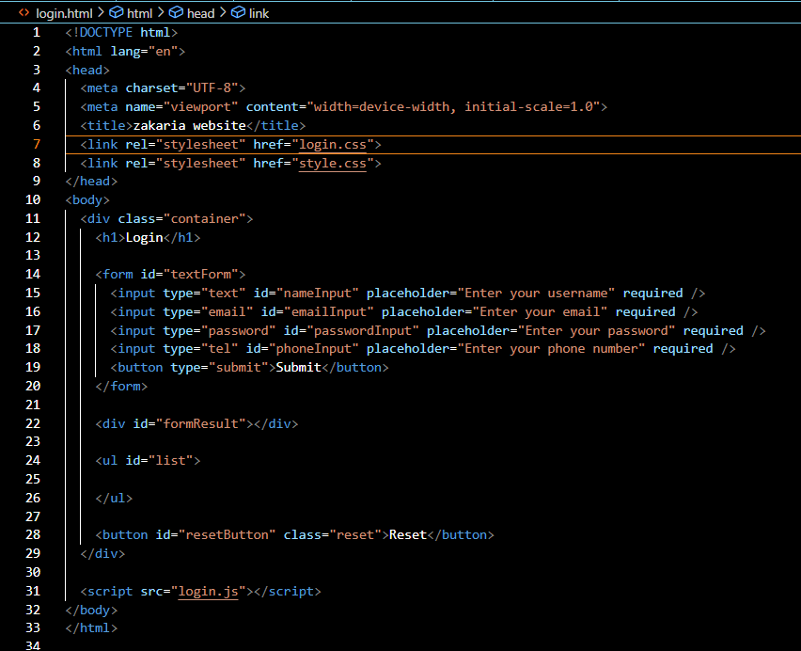
Login Page

Slide 9
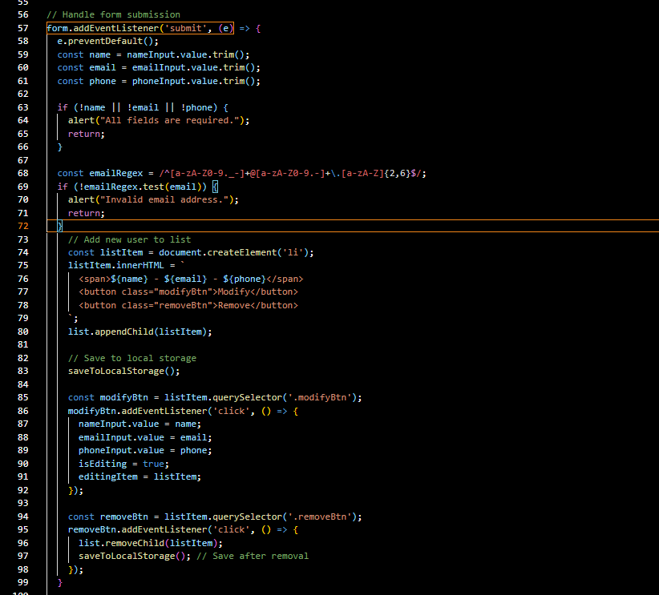
Create (Add New User)

Slide 10
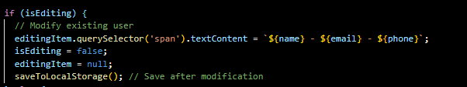
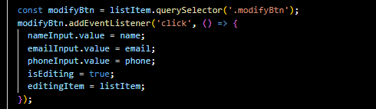
Update (Modify Existing Item)

Slide 11
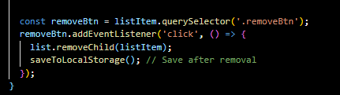
Delete (Remove Item)

Slide 12
CONCLUSION
This project successfully demonstrates the process of creating a web
application using core web development technologies: HTML, CSS, and JavaScript.
-Form Validation: The application performs form validation to ensure that
the data entered is correct and follows proper formatting (such as email
validation).
-CRUD Operations: With the use of JavaScript, the application implements
- Create, Read, Update, and Delete functionalities, enabling users to
manage their data dynamically.
- Persistence with Local Storage: The use of localStorage ensures that
the user's data persists even after the page is refreshed or closed.
- Error Handling: Basic error handling is implemented to provide feedback to users in case of invalid inputs or incorrect actions.

